Slide 1
Unit-1 Introduction to database management system

Slide 2
Introduction to DBMS
Section - 5

Slide 3
What is Database Management System (DBMS)?
Data - Fact that can be recorded or stored
e.g. Person Name, Age, Gender and Weight etc.
Database - Collection of logically related data
e.g. Books Database in Library, Student Database in University etc.
Management - Manipulation, Searching and Security of data
e.g. Viewing result in GTU website, Searching exam papers in GTU website etc.
System - Programs or tools used to manage database
e.g. SQL Server Studio Express, Oracle etc.
DBMS - A Database Management System is a software for creating and managing databases.
Database Management System (DBMS) is a software designed to define, manipulate, retrieve and manage data in a database.
e.g. MS SQL Server, Oracle, My SQL, SQLite, MongoDB etc.

Slide 4
Applications of DBMS
Section - 6

Slide 5
Applications of DBMS
DBMS is a computerized record-keeping system.
DBMS is required where ever data need to be stored.
E-Commerce (Flikart, Amazon, Shopclues, eBay etc...)
Online Television Streaming (Hotstar, Amazon Prime etc...)
Social Media (WhatsApp, Facebook, Twitter, LinkedIn etc...)
Banking & Insurance
Airline & Railway
Universities and Colleges/Schools
Library Management System
Human Resource Department
Hospitals and Medical Stores
Government Organizations
Write down any five applications of DBMS other than above.
Exercise

Slide 6
Advantages of DBMS
Section - 7

Slide 7

Reduce data redundancy (duplication)
Computer
Civil
Emp_Name | Address | Mobile | Subject
Emp_Name | Address | Mobile | Subject
Prof. ABC | India | 1234 | DBMS
Prof. ABC | India | 1234 | DBMS
Database management system can remove such data redundancy by storing data centrally.
Same data is stored at
four different places.
Emp_Name | Address | Mobile | Subject
Emp_Name | Address | Mobile | Subject
Prof. ABC | India | 1234 | DBMS
Prof. ABC | India | 1234 | DBMS
Electrical
Mechanical

Slide 8
Remove data inconsistency
Computer
Civil
Emp_Name | Address | Mobile | Subject
Emp_Name | Address | Mobile | Subject
Prof. ABC | India | 1234 | DBMS
6789
Prof. ABC | India | 1234 | DBMS
Database management system can keep data in consistent state.
Same data having
different state (values)
Mobile no is changed
Emp_Name | Address | Mobile | Subject
Emp_Name | Address | Mobile | Subject
Prof. ABC | India | 1234 | DBMS
6789
Prof. ABC | India | 1234 | DBMS
Electrical
Mechanical

Slide 9
Data isolation
Data are scattered in various files.
Files may be in different formats.
Difficult to retrieve the appropriate data.
File - 1
Emp_Name | Address | Mobile | Subject
Prof. ABC | India | 1234 | DBMS
DBMS allow us to access (retrieve) appropriate data easily.
File - 2
Emp_Name | Post | Salary | Load
Prof. ABC | Prof | 90,000 | 15
Data isolation is a property that determines when and how changes made by one operation become visible to other concurrent users and systems.
This issue occurs in a concurrency situation.
File - 3
Emp_Name | Teaching | Knowledge | Rating
Prof. ABC | Good | Excellent | 9

Slide 10


Guaranteed atomicity
Atomicity: Either transaction execute 0% or 100%.
Sum of both account before transfer is 3000
Person A
Account A
Bal : 2000
Transfer 500
Person B
Account B
Bal : 1000
Step 1 : Debit 500 from Account A
Step 2 : Credit 500 into Account B
Transaction is failed
Sum of both account is 2500
so inconsistent
Sum of both account
after transfer is 3000

Slide 11
Allow to implement integrity constraints
Emp_Name | Address | Mobile_No | Subject
Prof. ABC | India | 98XXXXXXXX | DBMS
Should contain exact 10 digits
Student_Name | Branch | Backlog | SPI
Nirav Shah | Civil | 0 | 8.5
Should be between 0 to 10
DBMS allows us to implement such business rules in our database..

Slide 12

Sharing of data among multiple users
Want to access
Computer
Civil
Emp_Name | Address | Mobile | Subject
Emp_Name | Address | Mobile | Subject
Prof. ABC | India | 1234 | DBMS
Prof. ABC | India | 1234 | DBMS
Want to access
Database management system allows more than one user to access same data simultaneously.
Emp_Name | Address | Mobile | Subject
Emp_Name | Address | Mobile | Subject
Prof. ABC | India | 1234 | DBMS
Prof. ABC | India | 1234 | DBMS
Electrical
Mechanical

Slide 13

Restricting unauthorized access to data
File - 1
Emp_Name | Address | Mobile | Subject
Prof. ABC | India | 1234 | DBMS
Wants to access
Faculty of other college
File - 2
Emp_Name | Post | Salary | Load
Prof. ABC | Prof | 90,000 | 15
Wants to access
Adani Institute Faculty
File - 3
Emp_Name | Teaching | Knowledge | Rating
Prof. ABC | Good | Excellent | 9
DBMS prevents unauthorized user to access data.

Slide 14
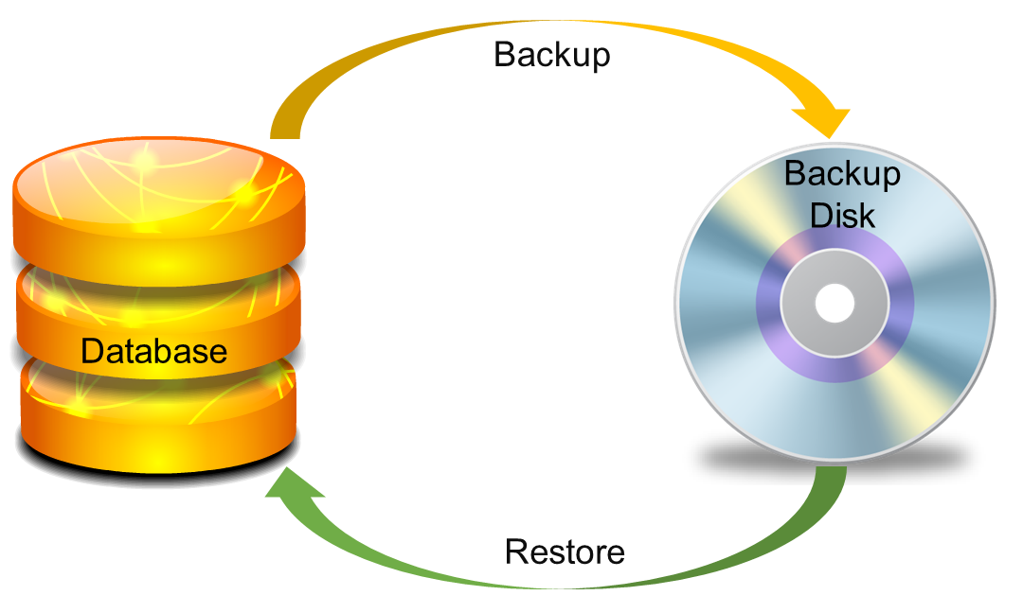
Providing backup and recovery services
Provides facilities to backup and restore the database in case of failure.

Slide 15
Advantages of DBMS (Summary)
Reduce data redundancy (duplication)
Avoids unnecessary duplication of data by storing data centrally.
Remove data inconsistency
By eliminating redundancy, data inconsistency can be removed.
Data isolation
A user can easily retrieve proper data as per his/her requirement.
Guaranteed atomicity
Either transaction executes 0% or 100%.

Slide 16
Advantages of DBMS (Summary)
Allow implementing integrity constraints
Business rules can be implemented such as do not allow to store amount less than Rs. 0 in balance.
Sharing of data among multiple users
More than one users can access same data at the same time.
Restricting unauthorized access to data
A user can only access data which is authorized to him/her.
Providing backup and recovery services
Can take a regular auto or manual backup and use it to restore the database if it corrupts.

Slide 17
Disadvantage of a database systems
Setup of the database system requires more knowledge, money, skills, and time.
The complexity of the database may result in poor performance.

